Slide 1
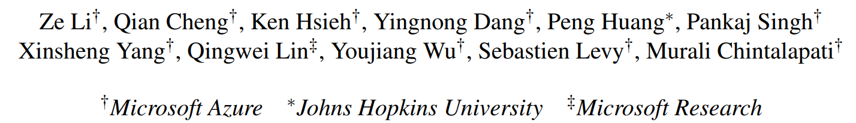
Gandalf: An Intelligent, End-To-End Analytics Service for Safe Deployment in Cloud-Scale Infrastructure
nsdi'20
黄家晏
2020.09.26

Slide 2
Content
Challenges
Solution
System Design
Algorithm Design
The advantages and disadvantages

Slide 3
Challenges
Various teams need to frequently make software changes in code and configurations.
even a small defect may lead to widespread failures with significant customer impact.
accurately assessing the impact of a deployment in a cloud system is challenging.
false negative: miss latent issues
false alarm:
mislead a local deployment health monitor to incorrectly attribute a failure to an innocent rollout.
cause the innocent rollout to be stopped and prevent timely changes from being applied.
developers also waste significant time and resources in investigating.

Slide 4
Solution
Gandalf -- an end-to-end analytics service for safe deployment of cloud infrastructure.
takes a top-down approach to assess the impact of rollouts holistically.
uses a lambda architecture to provide both real-time and batch deployment monitoring, with automated deployment decisions, a notification service.
detailed supporting evidence.
an interactive front-end.

Slide 5
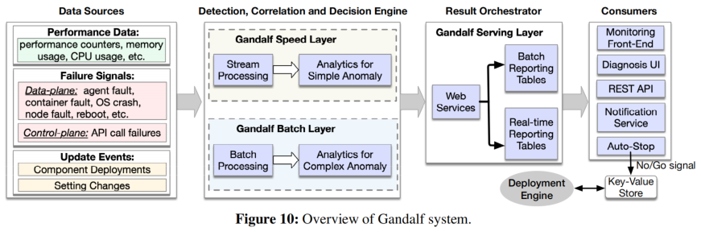
Gandalf System Design
1) Data Source：
Gandalf consumes comprehensive signals from various data sources.
performs pre-processing to parse the raw data and extract a failure signature .
aggregated based on their timestamps, node IDs and service types during the analysis.
2) Stream and Batch Processing：
designed in a lambda architecture [6] with both streaming and batch analysis engines.
The speed layer consumes data from a fast pipeline, Microsoft Kusto.
The Gandalf batch layer consumes data from Cosmos.
The lambda architecture allows us to provide both fast decision making and higher coverage over time.

Slide 6
Gandalf System Design
3) Result Orchestration and Actions：
implemented as a highly reliable and scalable web service using the Azure service fabric framework.
the results from the speed and batch layers are stored in two separate reporting tables.
Various DevOps applications pull the results from the reporting tables.
notification service.
4) Monitoring and Diagnosis Front-End：
provides a web front end to enable real-time rollout monitoring and issue diagnosis support for release managers and developers.

Slide 7
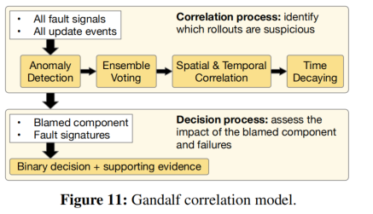
Gandalf Algorithm Design
The Gandalf model consists of three main steps:
(1) anomaly detection detects system-level failures from raw telemetry data.
(2) correlation analysis identifies the components responsible for the detected failures among multiple rollouts.
ensemble voting
temporal correlation
spatial correlation
exponential time decay
(3) the decision step evaluates the impacted scopen and decides whether the rollout should be stopped or not.

Slide 8
Gandalf Algorithm Design
1) Anomaly Detection
first replace the unique identifiers with dummy identifiers using an empirical log parser.
run a simplified incremental hierarchical clustering model to group up all processed text into a set of error patterns
detects anomalies based on the occurrences of each fault signature. Estimates the baseline from past data using Holt-Winters forecasting to detect anomalies.

Slide 9
Gandalf Algorithm Design
2) Correlation Analysis
correlate the observed failures with deployment events, and evaluate the impact of the failure on the fly.
ensemble voting
temporal correlation
spatial correlation
exponential time decay

Slide 10
Gandalf Algorithm Design
3) Decision Process
make a go/no-go decision for the component cj by evaluating the impacting scopes of the deployment such as the number of impacted clusters, the number of impacted nodes, number of customers are impacted, etc.
the decision criteria are trained dynamically with a Gaussian discriminant classifier.
4) Incorporating Domain Knowledge
allows developers to specify the importance of certain faults with customizable weights.

Slide 11
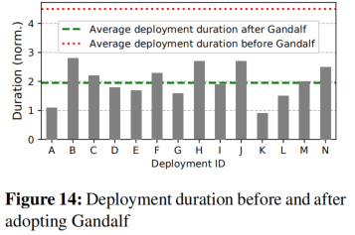
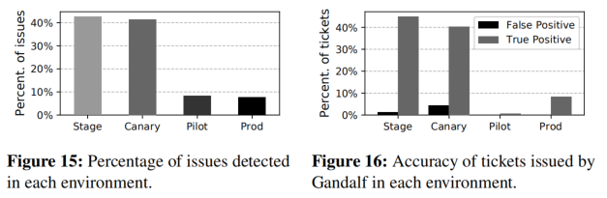
Evaluation
Adoption:
has been running in production and monitoring the Azure infrarollout safety for more than 18 months.
Scale:
processes on average 270K platform events daily,
770K events on peak days
logs about 600 million API calls per day in the control plane
The total data volume analyzed is more than 20TB per day.
development speed：
make decisions in about 5 minutes end-to-end on the speed layer, and in about 3 hours on the batch layer.
cuts the deployment time for the entire production fleet by more than half.
Accurately Preventing Bad Rollouts：
Gandalf blocked 99.2% of the bad rollouts before they enterproduction.
For data-plane rollouts, Gandalf achieved 92.4% precision with 100% recall.
For control-plane rollouts, Gandalf achieved 94.9% precision and 99.8% recall.

Slide 12
The advantages and disadvantages
Advantages：
Rich data set .
speed and batch processing are combined to achieve better detection speed and coverage.
Detailed report results and evidence content.
Support front end, convenient interaction.
Disadvantages：
Whether the portability is good.

Slide 13
Thanks

